Slide 1
2020 Data Analytics and Visualization Capstone
Sephora Products Recommender System
Xiaojia He

Slide 2
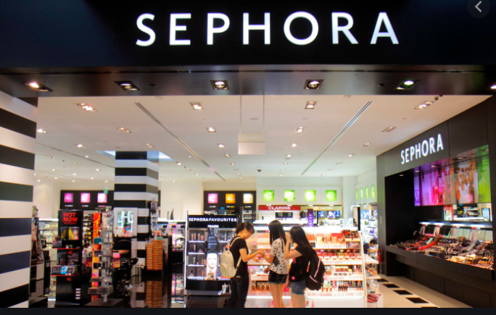
Sephora is a French multinational retailer of personal care and beauty products. It offers a variety of beauty products including cosmetics, skincare, body, fragrance, nail color, beauty tools, body lotions and haircare, and has miliion customers.

Slide 3
Motivation
At present in real industry, recommendation system is a good way to achieve these goals, especially for the e-commerce.
Why recommendation system?
Company – Increase sales by predicting consumer demands to recommend related products
Customer - Alleviate the problem of information overload and provide users with personalized content and services.

Slide 4
Objectives:
1. Learn multiple recommender systems and know their difference, advantages, and disadvantages
2. Know the whole process to build the recommender systems
3. Build the multiple recommender systems for Sephora and decide the best choice

Slide 5
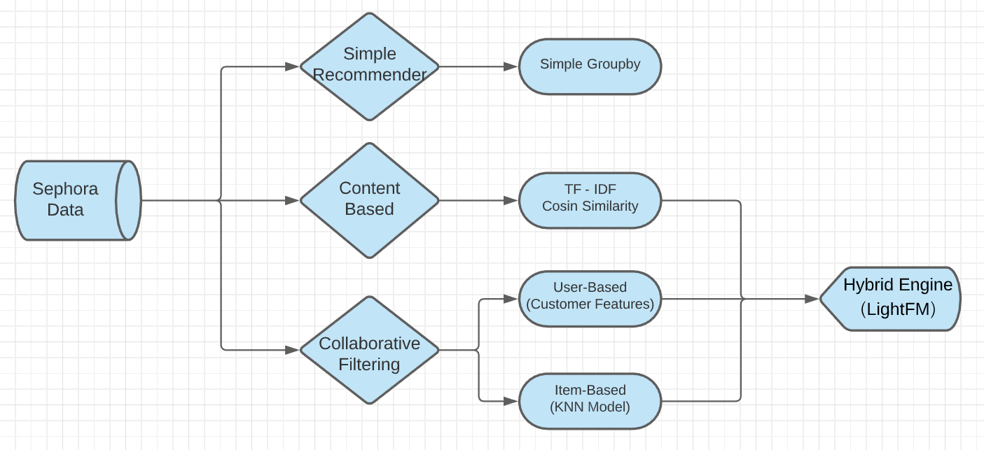
Recommender Overview

Slide 6
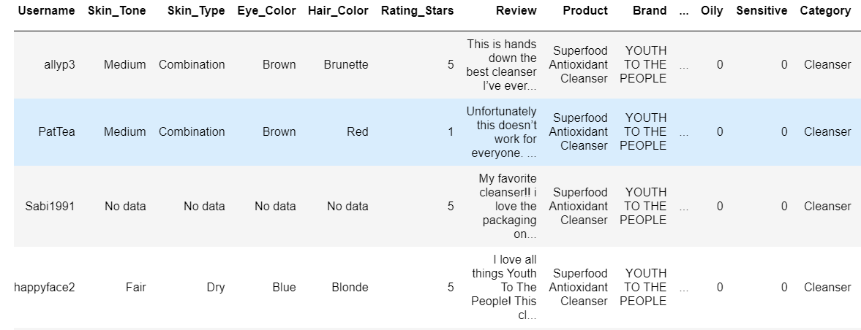
Dataset: 8649 × 25

Slide 7
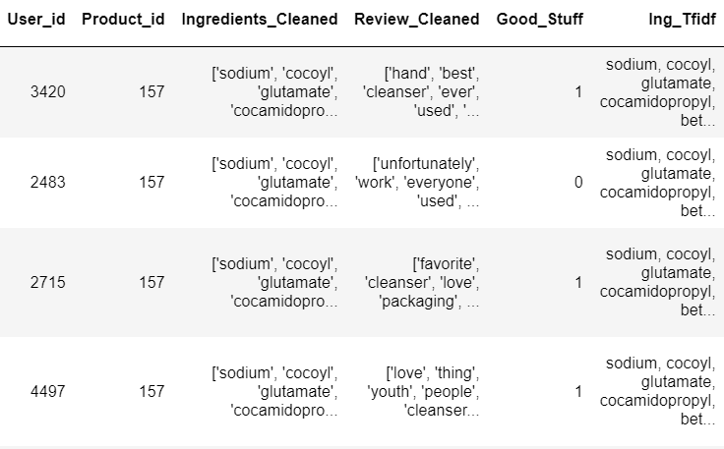
Dataset

Slide 8
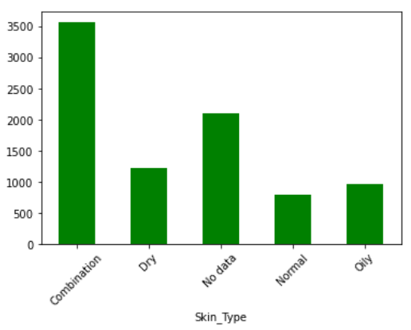
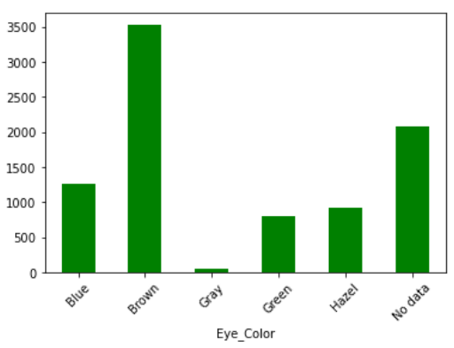
EDA - Data Distribution

Slide 9
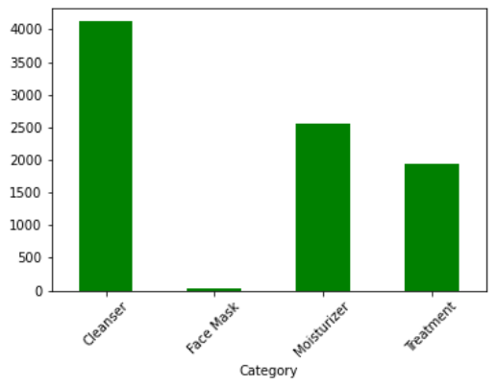
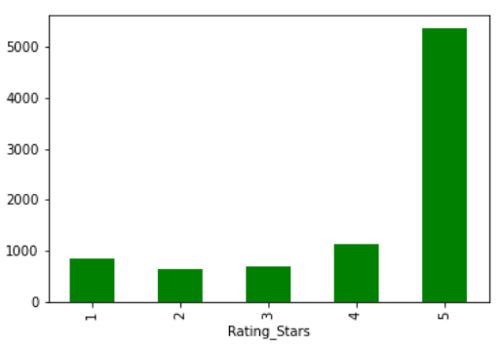
EDA - Data Distribution

Slide 10
Recommender System
Simple Recommender
Content Based Recommender
Collaborative Filtering
User Based Recommender
Item based Recommender
Hybrid Engine

Slide 11
Simple Recommender
The Simple Recommender offers recommendations according to different categories of products based on the sales popularity. The basic idea is to get the most popular products in each category and recommend these products to customers.

Slide 12
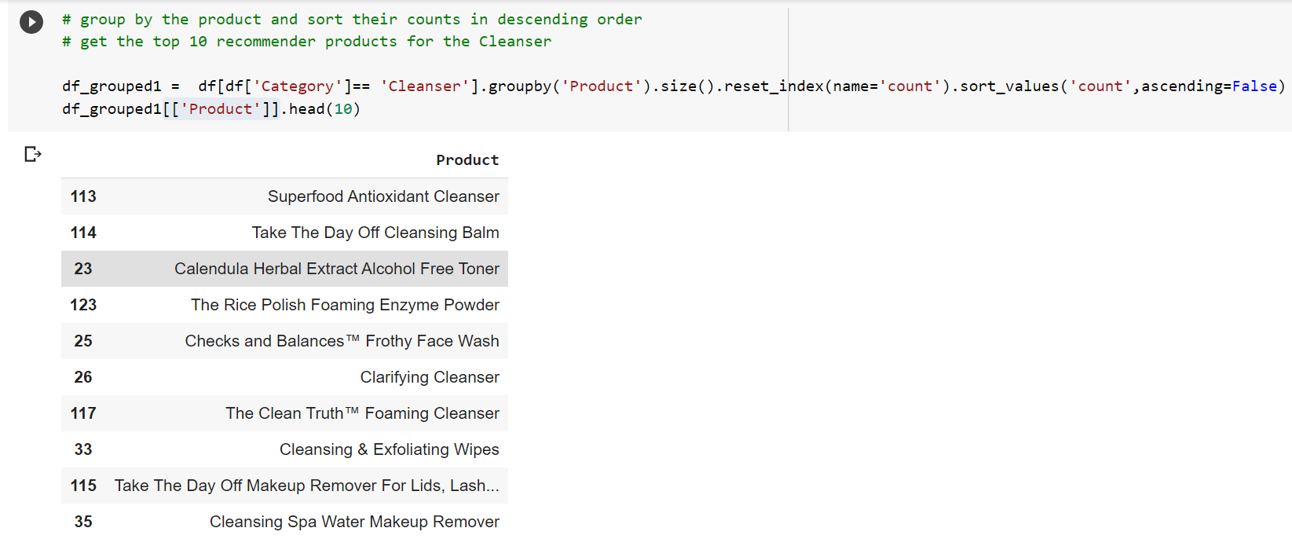
Simple Recommender for Cleanser

Slide 13
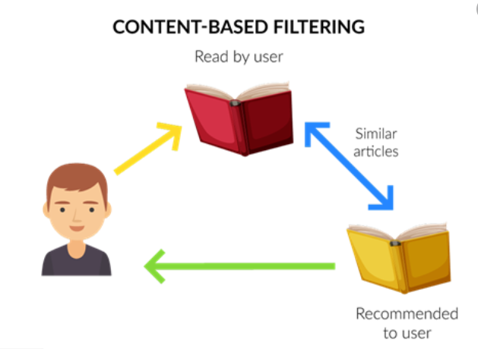
Content Based Recommender
An approach that recommends items based on the descriptions of that item. To be more specific, It explores the product information and try to find another products that have similar features recommend.

Slide 14
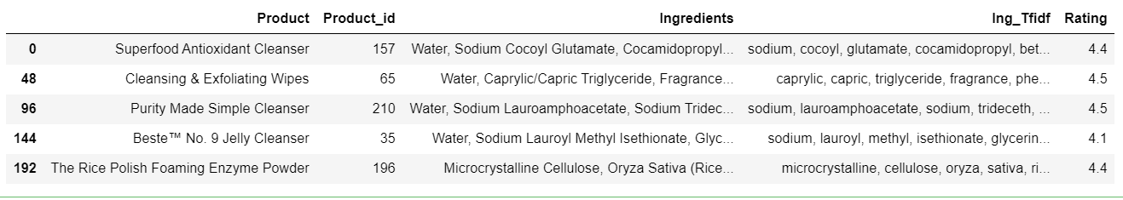
Product Data
Build Content Based Recommender based on information:
'Product', 'Ingredients', 'Product_id', 'Ing_Tfidf', 'Rating'

Slide 15
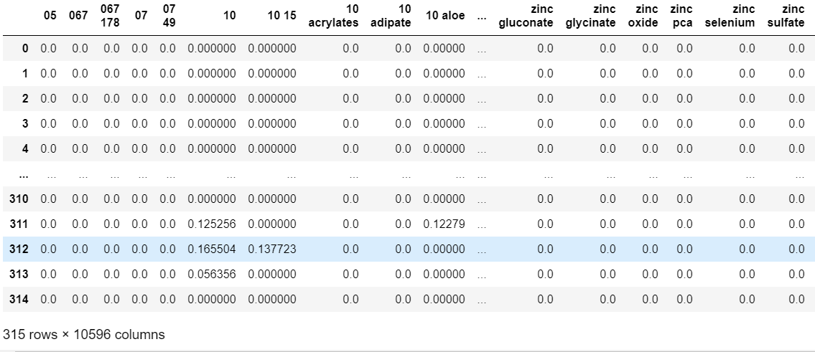
TF-IDF - Term Frequency-Inverse Document Frequency to deal with the text data to extract the ingredients from each products

Slide 16
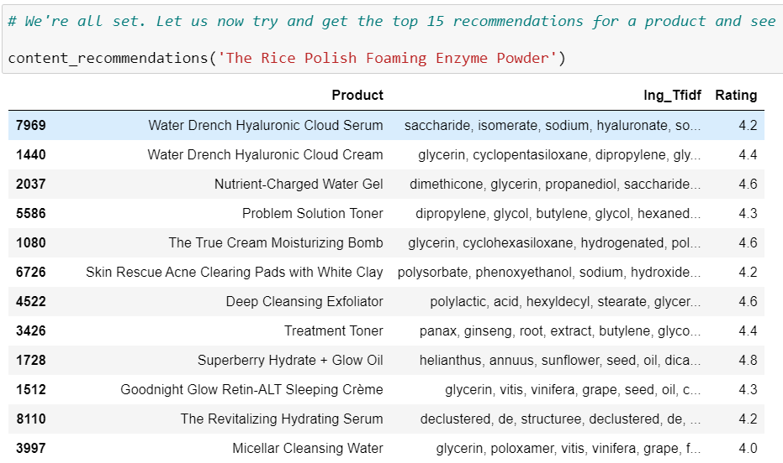
Content recommender

Slide 17
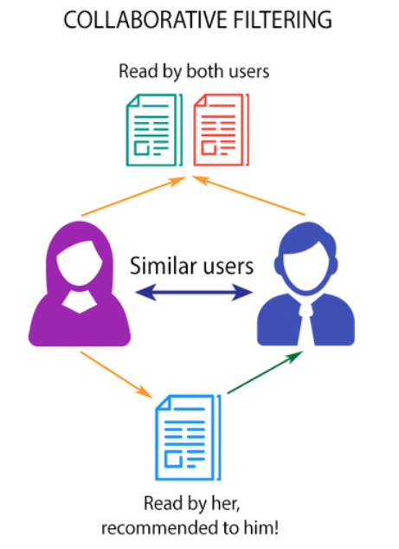
Collaborating Filtering
User based – Customer Features
User Based Collaborative Filtering uses similar interests between users to provide recommendations. For instance, if user A and user B both buy a product. We can recommend an item user A bought to user B

Slide 18

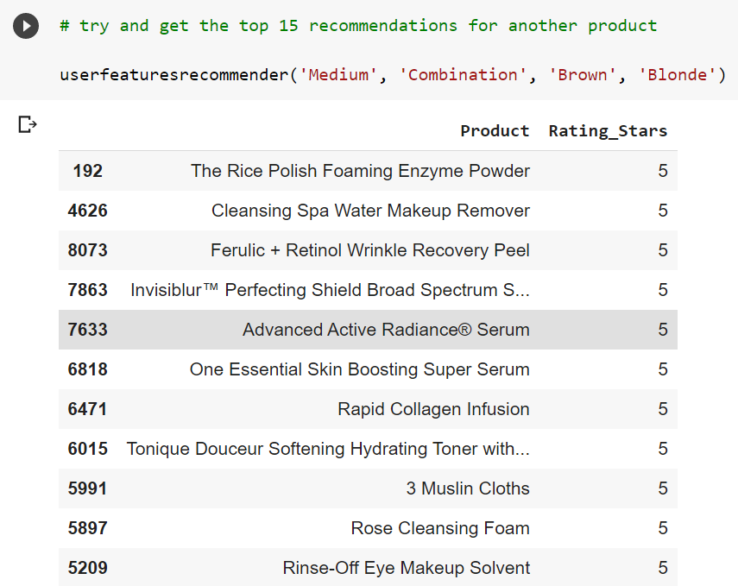
Similar Feature Recommender System
Use the similarity of the customers’ features to recommend products.

Slide 19
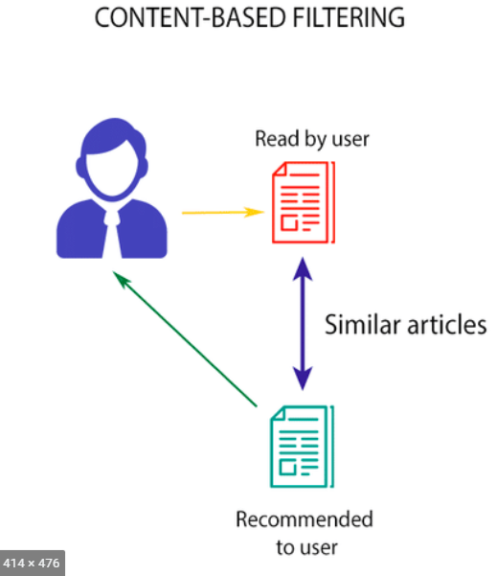
Collaborating Filtering
Item Based – KNN Model
Item Based Filtering uses the similarity of the items to find out the similar items to recommend. for example, if user A read an article A, we can assume that she may also like the article B that have the similar content to A.

Slide 20
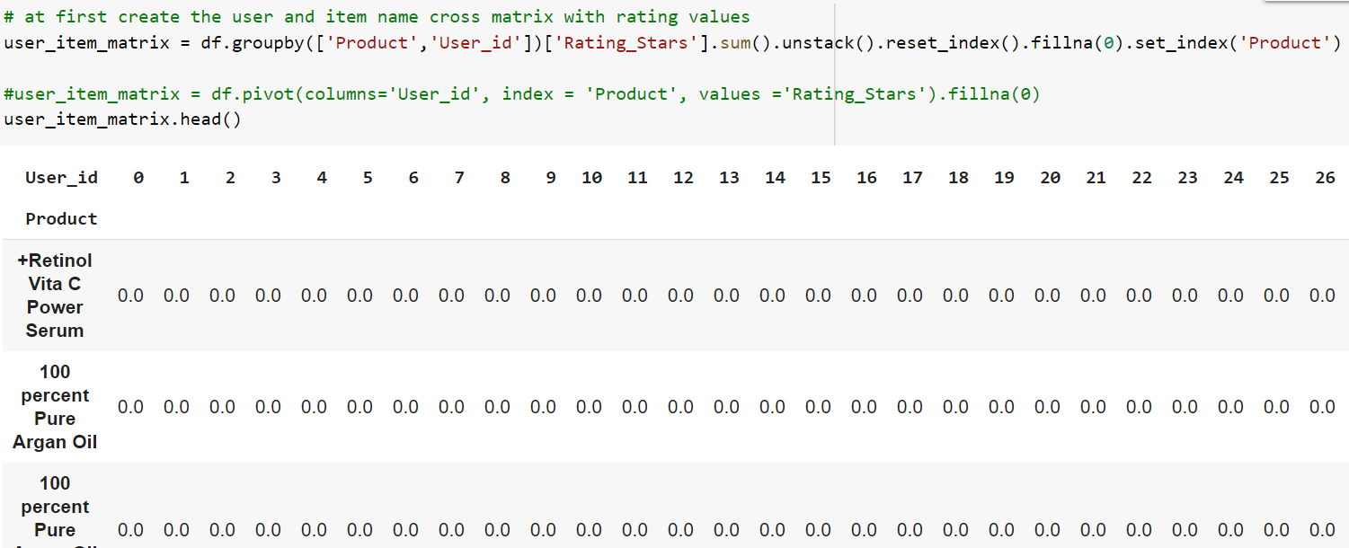
Collaborating Filtering
Item Based – KNN Model
Using k-Nearest Neighbors (Unsupervised algorithms ) to calculate the “distance” between the target product and every other products, then ranks its distances and returns the top K nearest neighbor products as the most similar product recommendations.

Slide 21
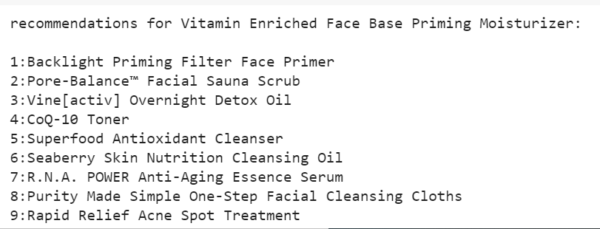
K Nearst distance Recommender
use cosine similarity for nearest neighbor search.Randomly choice the target product and recommend the nearst 9 products

Slide 22
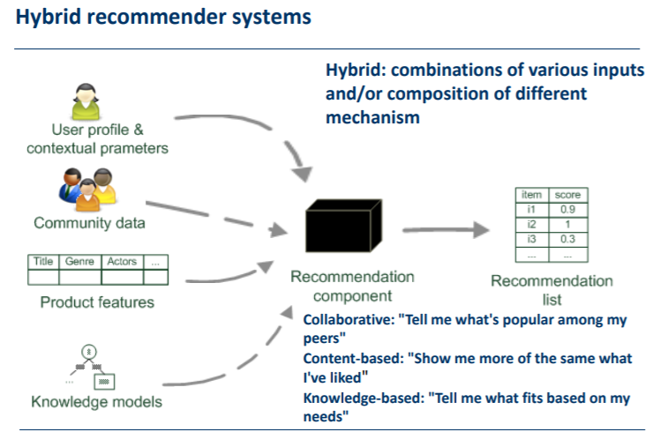
Hybrid Recommender
Combine the previous content and collaborative filtering methods together. it can be used to overcome the problems for the new product.

Slide 23
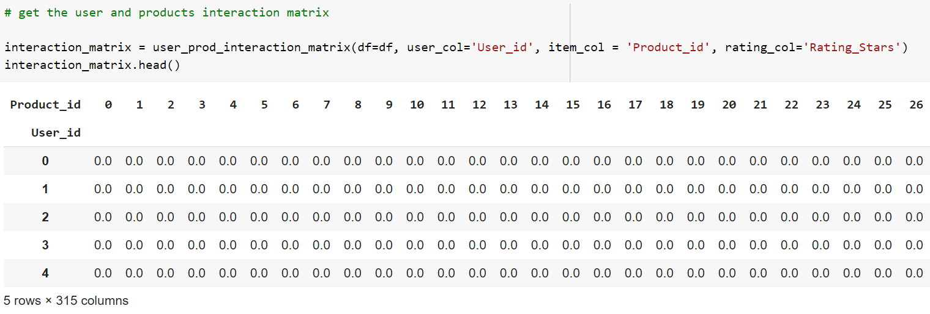
Hybrid Recommender
create the user - id and product - id interaction matrix with rating values
LightFM Fremwork – Matrix Factorization model

Slide 24
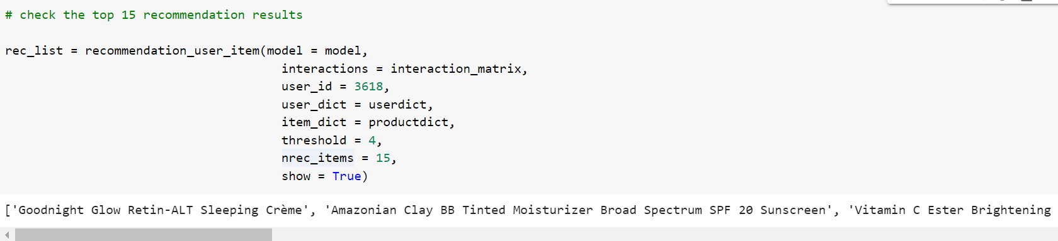
Combination Recommender
Through we combine the user and item together, this model can survive coldstart problem. It also recommend those products that has less users because of its weights.

Slide 25
Thank you

